Slide 1
Creating a Classwebsite
How? and Why?
GSU/TQP Technology PLC
July 2014

Slide 2
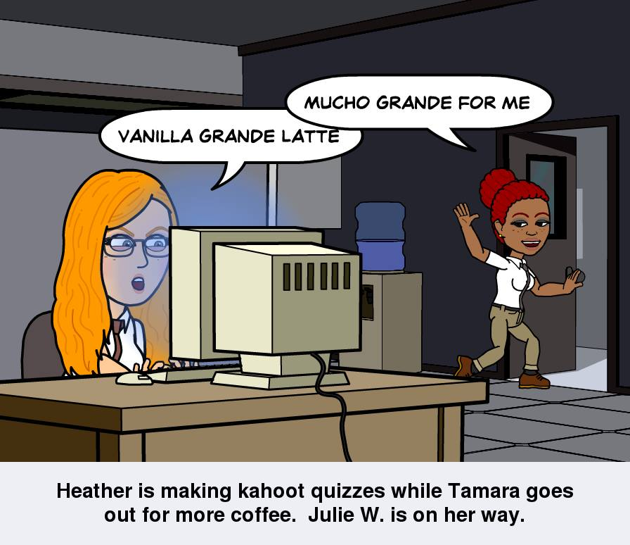
Tamara and Heather
District 147,
Harvey, Illinois
Washington Elementary
85% low income
K-5th School
3rd Grade Rocks!

Slide 3
Video Clip
bio video

Slide 4
Why...Why not?!
Efficiency
Communication
Experience
Resources
Standards

Slide 5
Why?.....Why NOT!
Efficiency
Students/Parents
Navigate Safely
Accountability
Increase time on task
Quick access to classroom 24hr/7days
Teachers
Planning Time
Behavior Tool
Saves trees!
Notes:
*Students learn to navigate the class page instead of wasting time searching the internet for correct site. *Teacher creates hyperlinks to quality, safe online resources that students and parents can quickly access and use from home as well.

Slide 6
Why?.....Why NOT!
Experience
Teachers
Improve your own technology skills
Stay relevant
Students/Parents
Learn to use digital resources
Develop positive “Digital Citizenship”
Notes:
*Students learn to navigate the class page instead of wasting time searching the internet for correct site. *Teacher creates hyperlinks to quality, safe online resources that students and parents can quickly access and use from home as well.

Slide 7
Why?.....Why NOT!
Resources
Teachers
Create a digital library of resources
Quick links to textbooks/sites
Post materials/videos for absent students
Students/Parents
Access quality resources anytime
Access to “flip” videos for learning extension
Parents can learn too!
Notes:
“1 stop shopping” Everything at your fingertips 24/7.

Slide 8
Why?.....Why NOT!
Communication
Teachers
Quickly post school to home info
“I didn’t know we had homework!” (Did you check the website?)
Students/Parents
Access to classroom info 24/7
Easy link to email teachers
Interact/collaborate with peers
Notes:
School to home, home to school...But also interacting in a more global sense with book buddies/pen pals. Check out “Epals” for a collaborative project with another class.

Slide 9
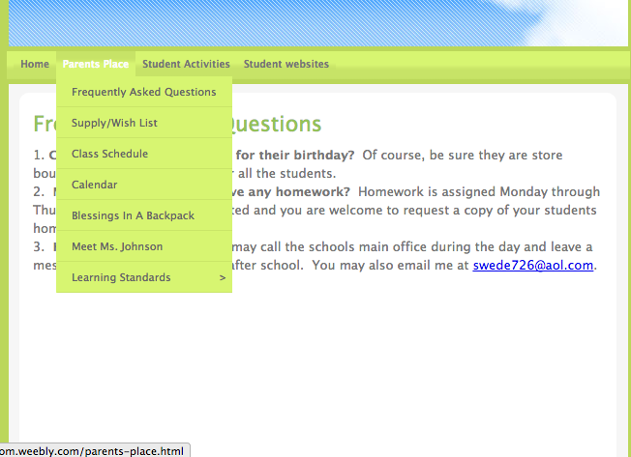
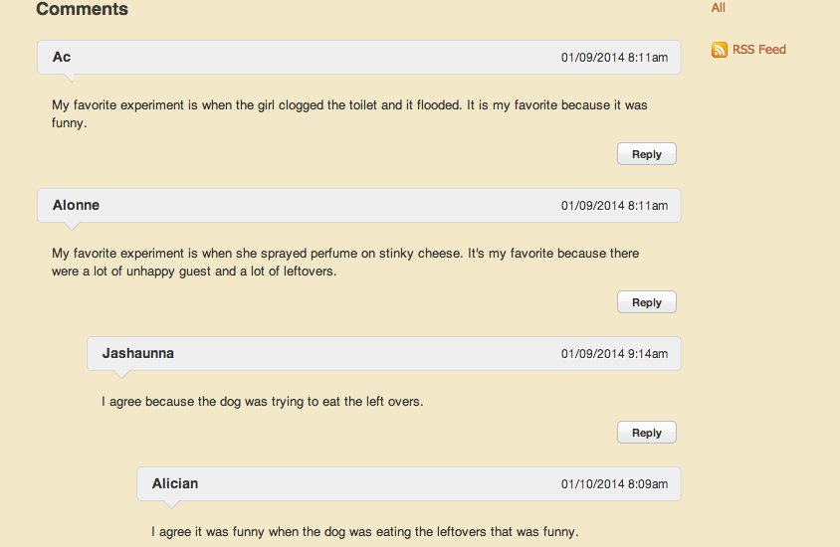
Communication
School/Home
Stay connected
students
parents
Student/Student
“Pen Pals”
“Book Buddies”
Notes:
Communication:
*Increase school to home communication-publish class newsletters, have an informative parent page, add a blog or contact box so parents can email you from your page.
*Student to student communication through blogs. Think “Pen Pals” or Book Buddies”.

Slide 10
Common Core Standards
Why?....Why NOT!
CCSS.ELA-Literacy.W.K.6 With guidance and support from adults…..digital tools to produce and publish writing, including in collaboration with peers
CCSS.ELA-Literacy.W.3.6 With guidance and support from adults, use technology to produce and publish writing (using keyboarding skills) as well as to interact and collaborate with others.
CCSS.ELA-Literacy.CCRA.W.6.6 Use technology, including the Internet, to produce and publish writing and to interact and collaborate with others.
CCSS.ELA-Literacy.W.9-10.6 Use technology, including the Internet, to produce, publish, and update individual or shared writing products…..
Share, Share, Share
Common Core
Family
Teacher Collaboration
Student Collaboration
Notes:
Share, share, share!:
*State standards require students publish writing. *Family can see what’s happening at school and stay connected.

Slide 11
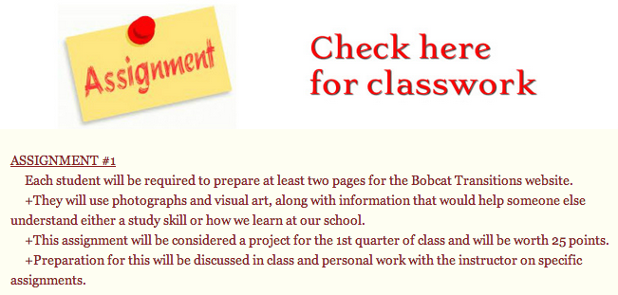
Class Site: High School
Notes:
Example of taking state standard and creating a website based assignment that is graded on a rubric. High school example.

Slide 12
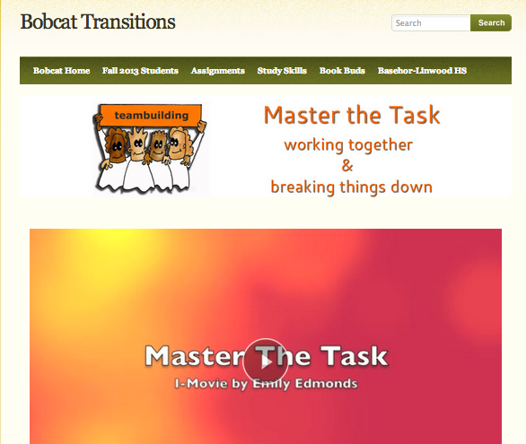
Class Example

Slide 13
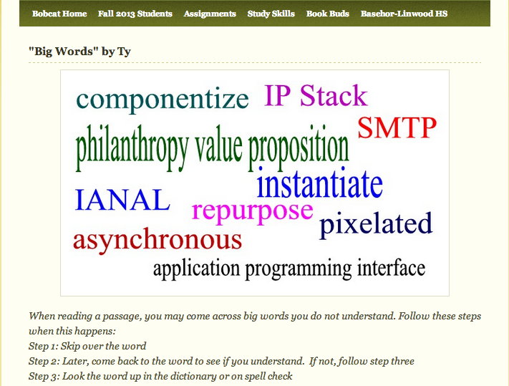
Class Example

Slide 14
Website Purpose
Content
Class
Student
Notes:
Three purposes for an ed site.

Slide 15
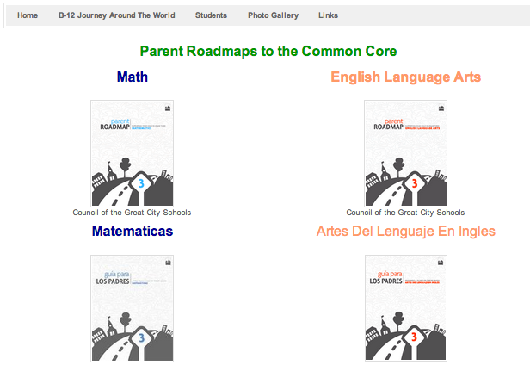
Class Website: Ms. Berrian
Bilingual Parent Resources

Slide 16
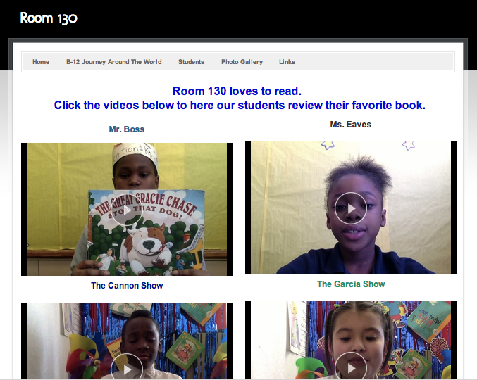
Class Website: Ms. Berrian
Student created
Video Book Reviews

Slide 17
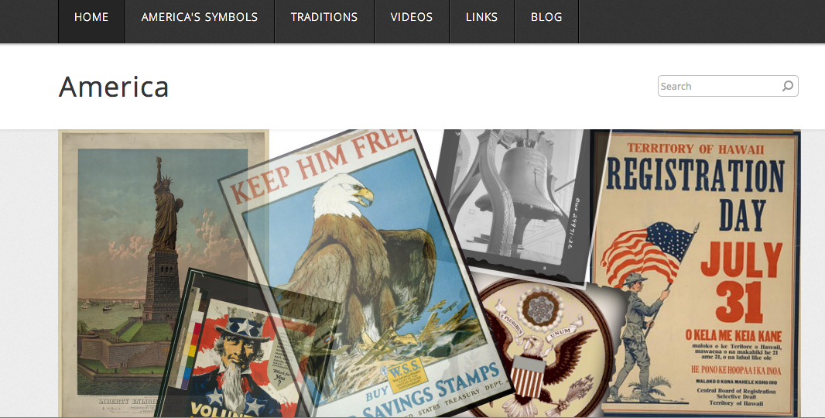
Content Specific Sites
Content Specific
ussymbol.weebly.com
Notes:
My first content site was Frida Kaolo biography project for Alyssa High School. We created this for summer school but elaborated when we had journey around the world theme.

Slide 18
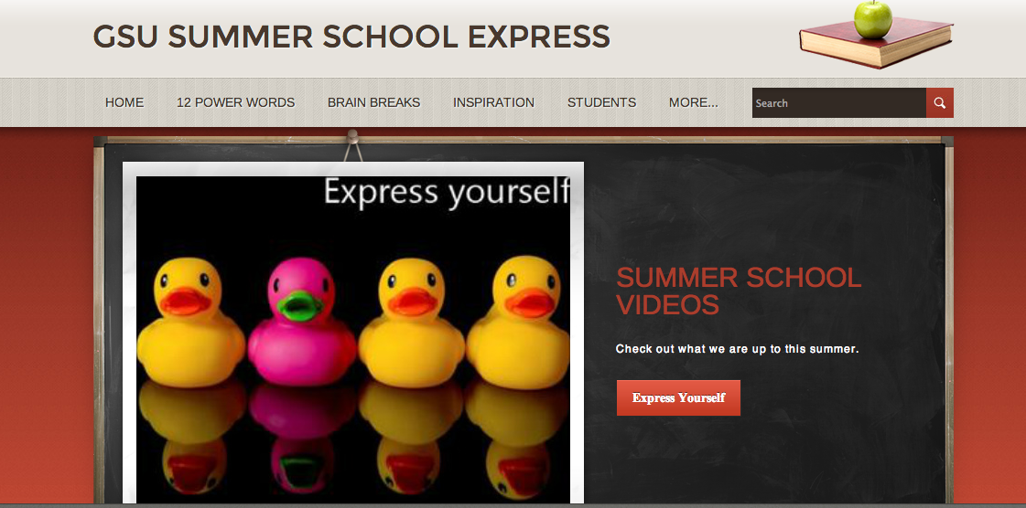
Content Specific
summerschoolexpress

Slide 19
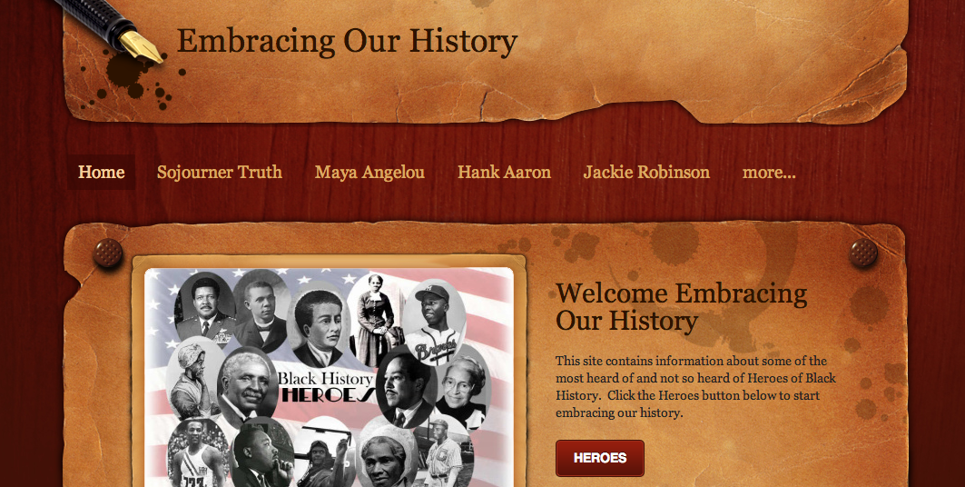
Content Specific
Black History Month
Notes:
Students are going to be assigned a person and they will add their research to the site.

Slide 20
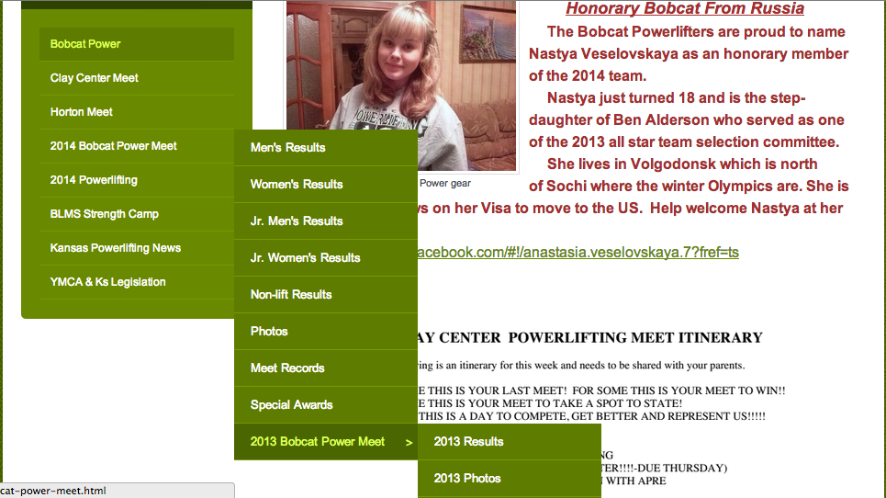
Sports/Organizations
Bobcat Powerlifting
Notes:
You can create a site specific to organizations at your school: cheer team, mathletes, Book of the month, Monarch books. This site has become a premiere site for powerlifting because it just didn’t exist before. Over 200 to 300 hits a day.

Slide 21
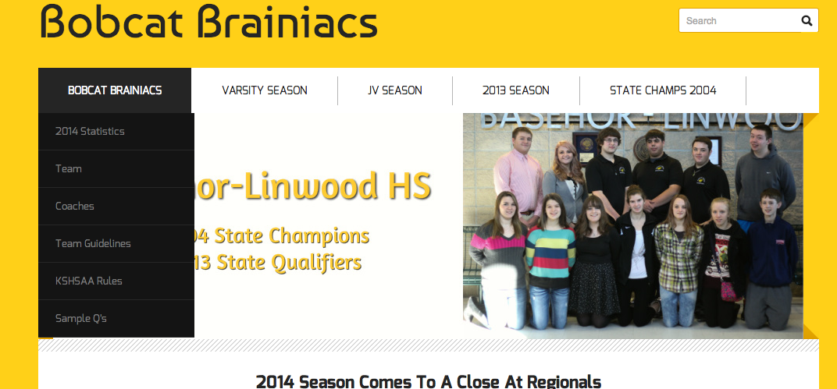
Brainiacs
Notes:
Example of organization site. This teacher post quiz material, practice tests on this site.

Slide 22
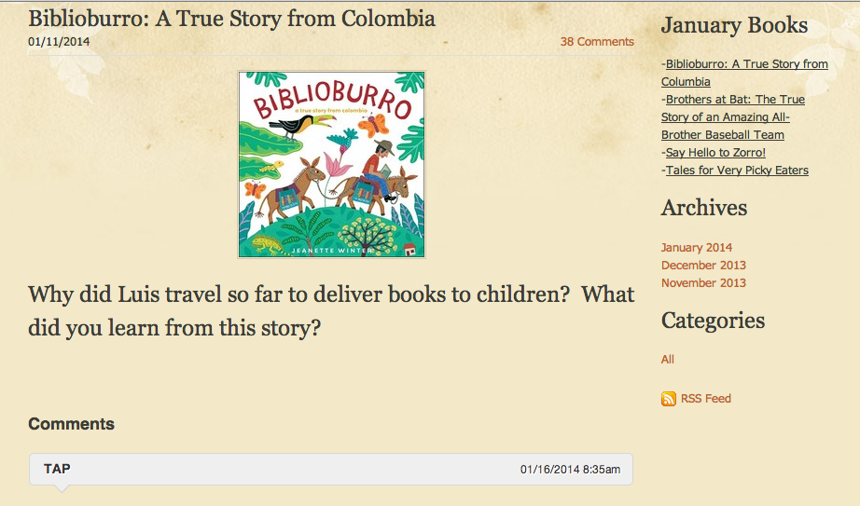
Monarch Award/Book of the Month
Notes:
Schoolwide site where students can interact re: book of the month or Monarch award winners. Students read, respond in writing, and respond to each other in blog.

Slide 23
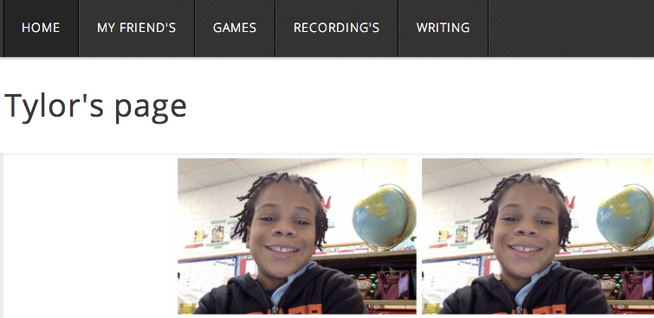
Student Website
Notes:
I require specific elements for student sites, examples could be home, writing, fluency recordings, pictures...

Slide 24
Student Websites
*Students learn website creation
*Publish and share writing
*Express themselves creatively
*Develop 21st century skills
-copy/paste
-insert text box/image
-cite sources
-add video
Notes:
Example of student writing published to his student website.

Slide 25
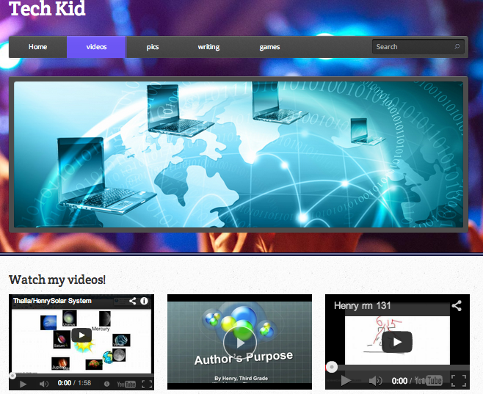
Student Website
Student Example
Notes:
Example of how kids want to put as much as possible onto a page. Henry publishes his tutorial videos on his website.

Slide 26
Student Sites as a Grade
-Teach website expectations (digital citizenship)
*never use full name or disclose personal info
-Create guidelines for appropriate content
*all content should be relevant to teachers requirements
*no inappropriate content
*no one wants to see 100 pictures of Beiber/hearts/puppy dogs...
-Demonstrate how to log in/create/add images/add links
-Create a rubric for content and assessment
-Allow access to computer/Ipads during classtime
*small group/center *classroom computer sign up
*computer lab
Notes:
Not talking to this too much. Put in for reference?

Slide 27
How?
Find a site
user friendly
start simple
free

Slide 28
weebly.com
Very user friendly
Free for basics plus 40 student accounts
Easy to manage, add, and edit
Notes:
Don’t have to show whole video, first couple min if running short of time.

Slide 29
Resources
weebly.com (Our fave!!)
wix.com
schoolrack.com
kafafa.com
yola.com
Jimdo.com
snappages.com
webnode.com
webs.com

Slide 30
Notes
Give your website a simple name with no punctuation marks (easier to send kids to)
Learn how to screencapture images to create “buttons” that you can link to a website
Don’t clutter your pages with lots of images and text
-Use slideshows to show multiple images
-Try to maintain a consistant theme/colors
Notes:
Random notes/thoughts: don’t know if we need them but sticking them somewhere to think about.

Slide 31
Thanks!!
Find this presentation at:
msjohnsonsroom.weebly.com
room130.weebly.com
Contact us:
urbanedteachers@gmail.com

Slide 32
Notes:
Weebly help video by Heather (in case internet is not working)

