Slide 1
IPad Basics Bootcamp
Heather Johnson
District 147
Technology Integration Specialist

Slide 2
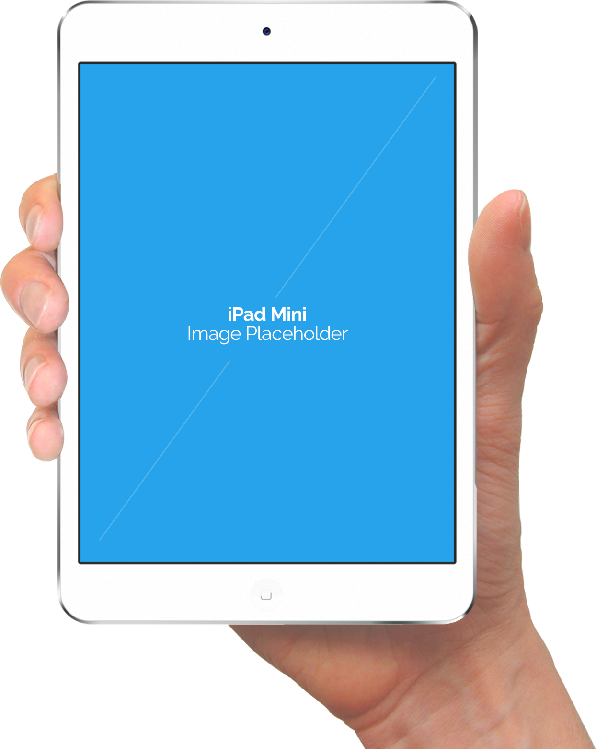
Twitter: @techplc
Web:
tqptechplc.weebly.com
msjohnsonsroom.weebly.com
Facebook:
TQP Technology PLC
Email: hjohnson@whd147.org
Contact Me...

Slide 3
Use any device
Go to kahoot.it
Enter game pin and nickname
Wait for teacher to launch quiz!
Good Luck!!!!
Click image to go to Quiz!

Slide 4
Teachers go to:
getkahoot.com
Students go to:
kahoot.it
*Teachers create or select a quiz and launch on screen.
Click image to go to getkahoot.com

Slide 5
App in Action:
Ms. Berrian’s Third Grade
Visit Ms. Berrian’s Third Grade class as they do a multiplication review.
Click image to go to link.

Slide 6
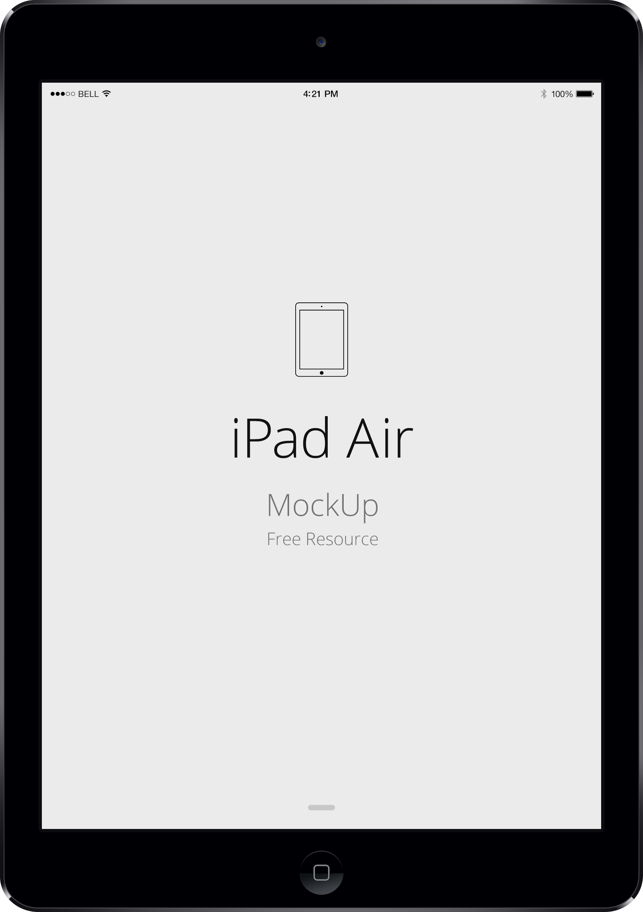
IPads and
Common Core State Standards
Use a variety of digital tools to produce and publish writing including in collaboration with peers with multi media components (graphics, sound, video) in presentations.

Slide 7
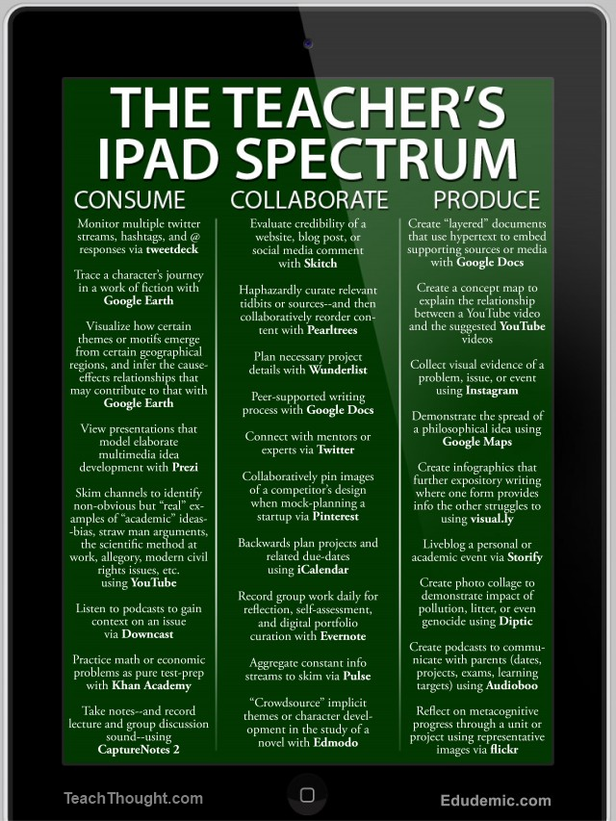
Consume:
*View
*Practice
*Research
*Skim
*Listen

Slide 8
Collaborate:
*Plan
*Connect
*Record group
*Co-Edit Docs
*Blog

Slide 9
Produce:
*Create Docs
*Presentations
*Photocollage
*Infographics
*Podcasts
*Multimedia creations
*Digital Storytelling
*Much More

Slide 10
How to bookmark and add a shortcut

Slide 11
Use the camera!!
Take a picture of each student for class movie or end of year video.
Record videos of students introducing themselves or setting a goal for the year.
Students record themselves reading a passage or readers theater (fluency).
Students create a video book report.
Take pictures of work to create a digital portfolio for parents.
Students produce and record a commercial or record a persuasive debate.

Slide 13
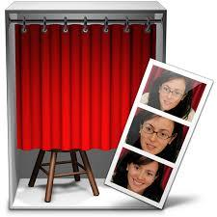
Photobooth
Animoto
*Record steps of a science experiment
*Show sequence
*Picture Collage reports
*Istrips App (free): makes photo strips
*Trading Card App
*Video Book Reports
*Book Review: Teacher Example
*Fluency Practice
*Reader’s Theater

Slide 14
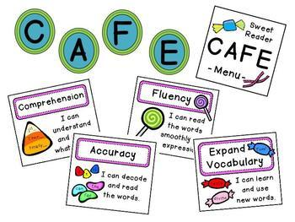
Daily 5 Cafe Blended Digital/Traditional
readerworkshop.weebly.com

Slide 15
Literacy: Leveled Books
*IBooks-search “Free Books” to stock shelves or
have your students create books and save them to ibooks.
*Word Zoo Book 2 (10 color coded books to learn first 100 words).
*k-5 Mobile School Reading (100 books k-2 and beginner readers).
*Reading A to Z (Paid)
*Reading Eggs (Paid)

Slide 16
Creative Apps

Slide 17
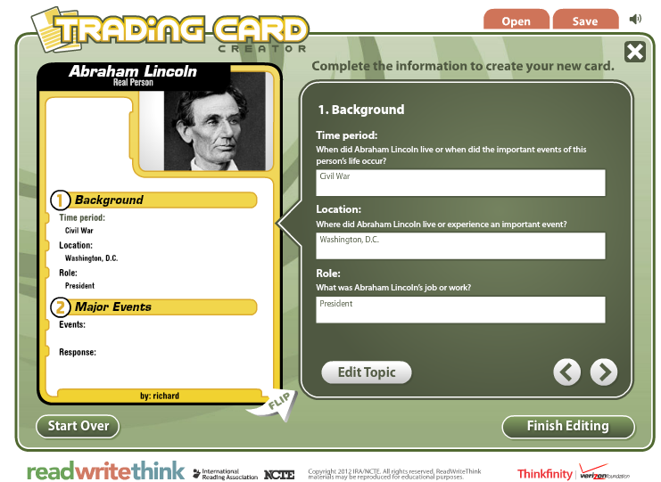
Trading Card App (Free)
Character Study
Biography Summary

Slide 19
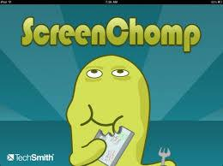
Digital Slates
Screenchomp
Chalkboard (Free)
Glowpaint (Free)
Educreations
(Basic Free)

Slide 20
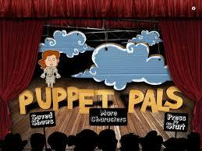
Digital Storytelling
Bookcreator
Puppetpals

Slide 21
BookCreator
How to...Book
Collaborative Books: ABC’s, Vocabulary Collection…
Sentence Starters
Non-Fiction Book: Research and share
Photo Books: “Geometry in the real world”
Blog Information Source: redjumper.net Click to view examples on the blog.

Slide 22
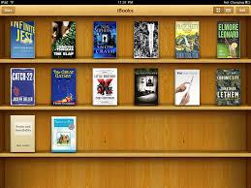
IBooks
*Search “Free Books” to download many, including some audio books.
*Save your own Bookcreator books in IBooks.

Slide 23
Chatterpix/Chatterkid
Animate any image and record a voiceover.
Add decorations and borders.

Slide 24
Chatterpix/Chatterkid
*Students create a self portrait and record an “All About Me” speech.
*Take a picture/drawing of a character, record student describing that their traits or actions in the story.
*Illustrate poetry or writing and record reading.
*Draw or take a picture of famous person and read about them. Create a museum walk of bio videos linked to QR codes.

Slide 25
Examples:
msjohnsonsroom.weebly.com
room130.weebly.com
Ms. Batchelor’s 3rd
Grade Room

Slide 26
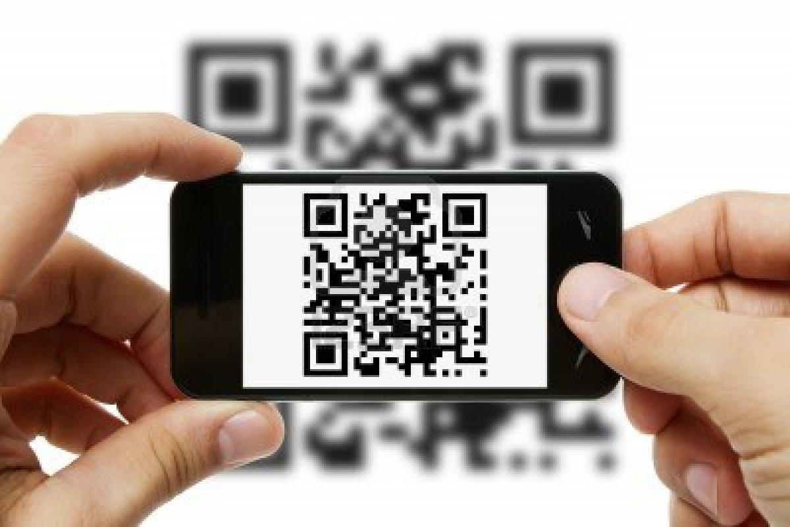
QR Codes

Slide 27
QR Codes (Quick Response Codes)
*Are barcodes of information that link the physical world with the online world.
*They are considered “augmented reality”.
*Save paper! Interactive/engaging.

Slide 28
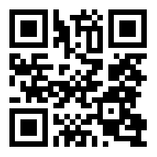
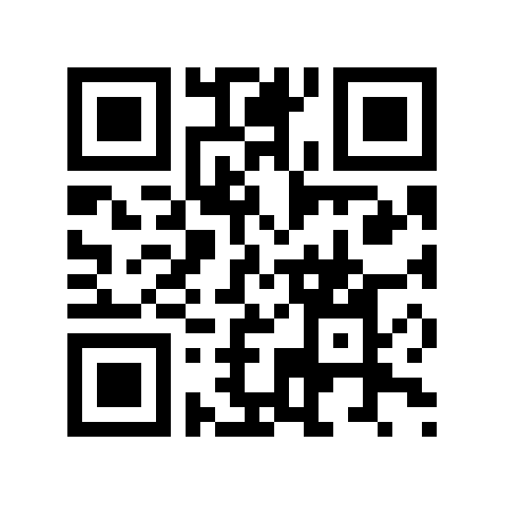
*Take students to video content without asking them to type in a URL. Respond to prompt in journal.
*Example: Stokely Carmichael Video Clip:
Leader of the Student Nonviolent Coordinating Committee, speaks to a crowd in Mississippi in 1964.
Video Writing Response Prompt: Student responds in their journal.
qrvoice.net

Slide 29
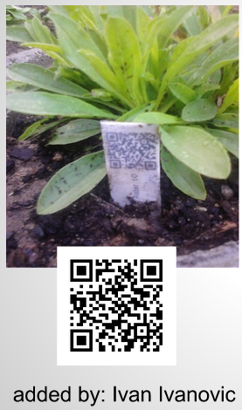
QR Codes (Quick Response Codes)
*Create a virtual museum tour around the room
*QR Plants: Code takes you to plant info
*qrvoice.net Change text to speech
*QR Code Generator to create them.
*QR Code Treasure Hunt Generator

Slide 30
Create a series of codes/sheets using vocabulary or test questions. It generates a code for each question and students must record their answers.

Slide 31
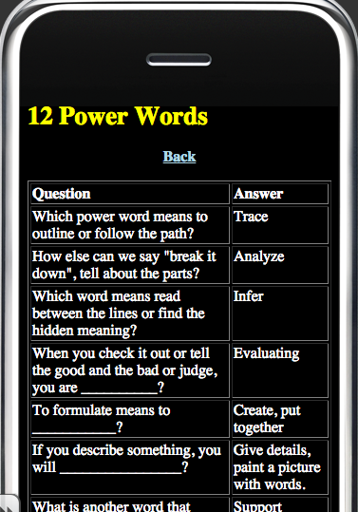
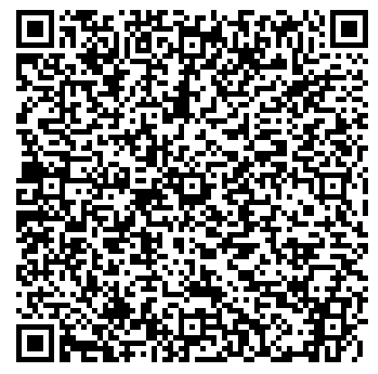
Answer Key

Slide 32
Aurasma -Augmented Reality App
Voice Thread
Audioboo
Jot It Down
Autorap/Songify
Google Earth
Additional Apps
to check out...

Slide 33
Helpful Slide Presentation

Slide 34
Scholastic Story Starters: Writing
http://www.scholastic.com/teachers/story-starters/
Check
this out...

Slide 35
Photo Sources:
http://tech-kid.com/ipad-air-transparent-background.html

