Slide 1
Academic Vocabulary
Practice Book

Slide 2
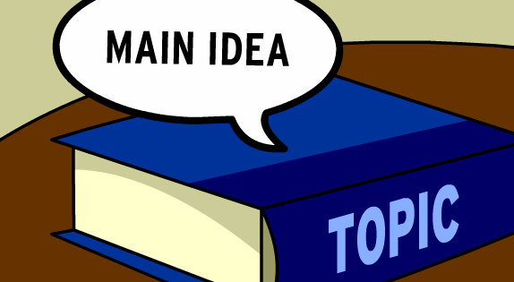
What is a Main Idea?

Slide 3
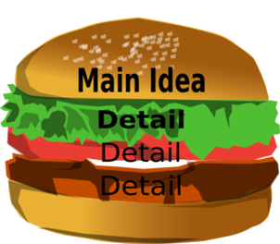
What is a detail?

Slide 4
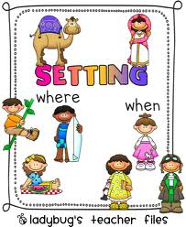
What is the Setting?

Slide 5
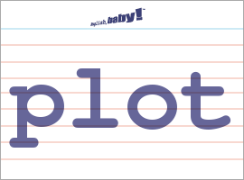
What is the Plot?

Slide 6
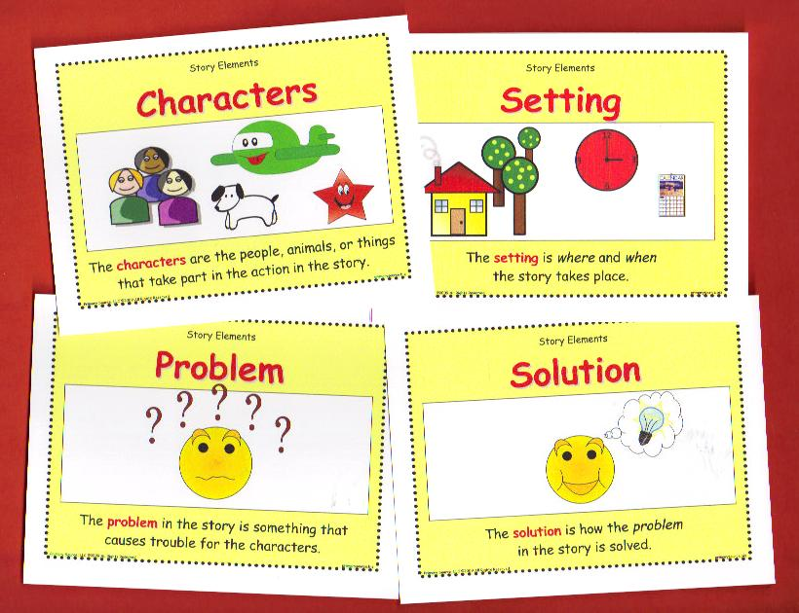
What are story elements?

Slide 7
Study and review the definitions!

Slide 8
Main Idea
What the author wants you to understand the most
Can be found in the title
Can be found in the first sentence
Can be found in the first paragraph
Sometimes you must infer

Slide 9
Detail
An example from the story that supports or proves the main idea

Slide 10
Setting
Where the story takes place
When the story takes place
The setting can change

Slide 11
Plot
The beginning, middle, and end
The problem and solution
The important events that take place in a story

Slide 12
Story Elements
The elements that work together to develop a story
Characters
Setting
Plot
Main idea/details
Problem and solution

