Slide 1
Changing States of Matter
A matter simulation
by Ms. Heather Johnson

Slide 2
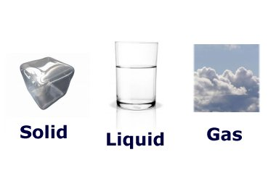
Objective
Understand the three states of matter and the transitions between them.
Image from ducksters.com

Slide 3
What is matter?
Matter is anything that takes up space.
Matter exists in different states such as solids, liquids, and gases.
It can change from one state to another by heating and cooling.

Slide 4
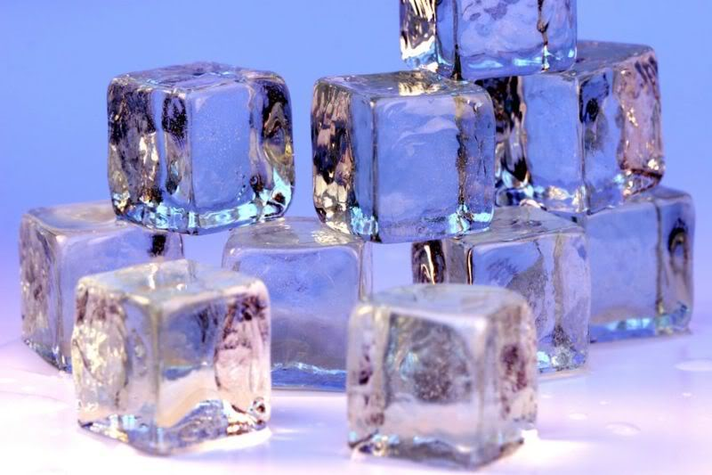
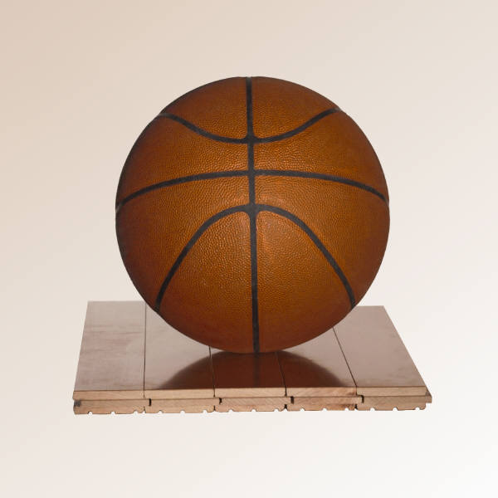
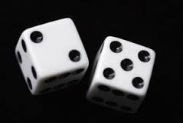
Solid
Has its own shape and it takes up space.
You can see and touch a solid.
Ice is an example of solid water

Slide 5
Liquid
Takes the shape of its container.
Can have properties like transparent or clear, bubbly or foamy.

Slide 6
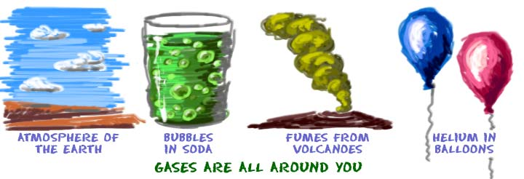
Gas
Can be hard to see, like the air around us.
Other examples: steam, smoke, clouds

Slide 7
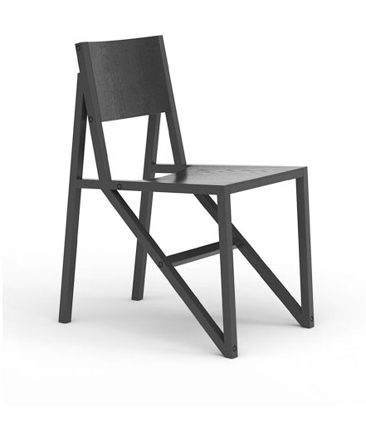
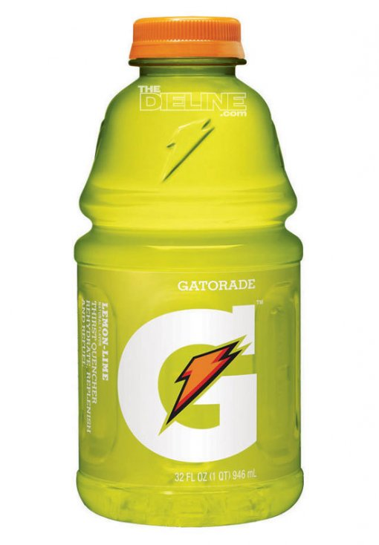
Quick check…
Click on the picture that is an example of a liquid.

Slide 8
Sorry, that is not a liquid.

Slide 9
Yes, Gatorade is a liquid!

Slide 10
Changing Matter
The matter around us is at room temperature.
We can change matter into its other states by heating it up or cooling it down.

Slide 11
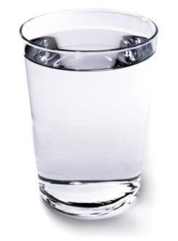
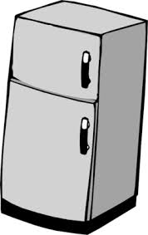
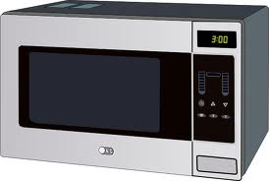
Liquid into a solid
If we cool water down to its freezing point, it will turn into solid ice.
Click on a tool to freeze our water into a solid.
microwave
refridgerator

Slide 12
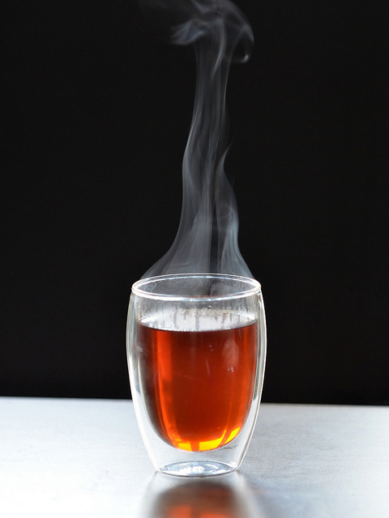
No, a microwave heats up the water. Guess I’ll have a cup of tea.

Slide 13
Yes, a freezer could change liquid water into solid ice.

Slide 14
Solid to a Liquid

Slide 15
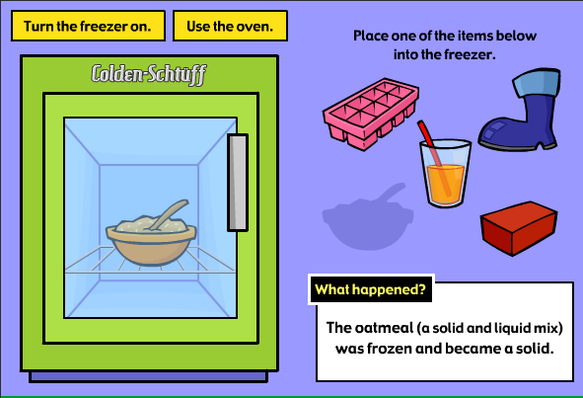
Check out this simulation to see how different types of matter change.
http://archive.fossweb.com/modulesK-2/SolidsandLiquids/activities/changeit.html

