Slide 1
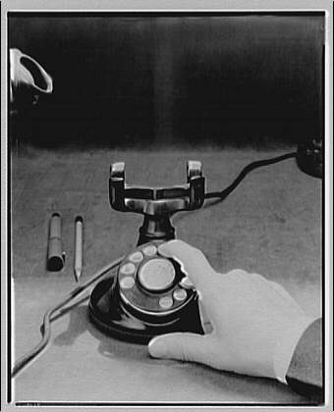
American Treasures
Please have a cell phone or laptop available
for the beginning of our session. Thanks!
Of the Library of Congress

Slide 2
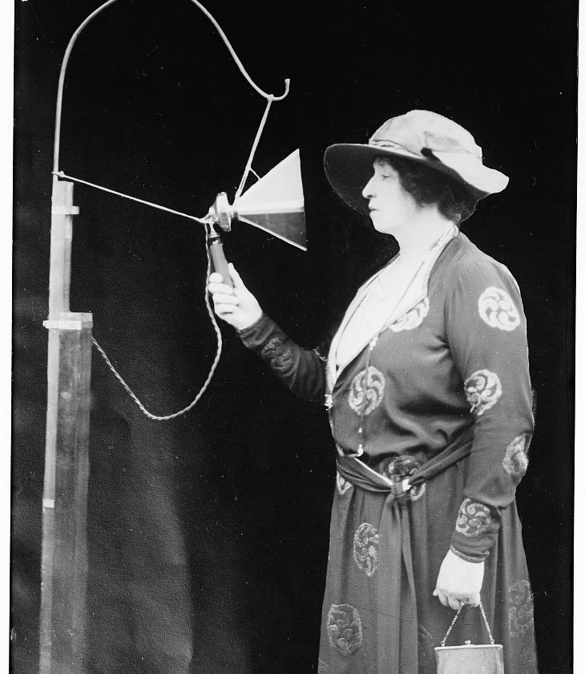
Melba and Wireless phone
Title: Melba & wireless phone
Creator(s): Bain News Service, publisher
Date Created/Published: [no date recorded on caption card]
Medium: 1 negative : glass ; 5 x 7 in. or smaller.
Reproduction Number: LC-DIG-ggbain-30836 (digital file from original negative)
Rights Advisory: No known restrictions on publication.
Call Number: LC-B2- 5242-11A [P&P]
Repository: Library of Congress Prints and Photographs Division Washington, D.C. 20540 USA http://hdl.loc.gov/loc.pnp/pp.print
Notes:

Slide 3
Share an item you treasure…
Mobile Device:
*Begin a text message to number 37607,
In the text box –
Type in 185042 and your answer,
Hit send.
Laptop:
*Go to pollev.com and type in code 185042 and response and send.

Slide 4
*Begin a text message to number 37607, Type in 185042 and your answer, Hit send.
OR go to pollev.com and type in code and response.
Notes:
<?xml version="1.0" encoding="ISO-8859-1" ?>
<poll url="http://www.polleverywhere.com/free_text_polls/SDuJFutoI1X0I2u">
<!-- This snippet was inserted via the PollEv Presenter app -->
<!-- The presence of this snippet is used to indicate that a poll will be shown during the slideshow -->
<!-- TIP: You can draw a solid, filled rectangle on your slide and the PollEv Presenter will automatically display your poll in that area. -->
<!-- The PollEv Presenter app must also be running and logged in for this to work. -->
<!-- To remove this, simply delete it from the notes yourself or use the PollEv Presenter to remove it for you. -->
<title>Share one item you possess that you consider a "treasure".</title>
</poll>

Slide 5
What are Primary resources?
Primary sources are the raw materials of history — original documents and objects which were created at the time under study.
They are different from secondary sources, accounts or interpretations of events created by someone without firsthand experience.

Slide 6
Exhibition Overview
The American Treasures of the Library of Congress exhibition is a permanent exhibition of the rarest, most significant items relating to America's past.
The American Treasures exhibition presents more than 250 items arranged in the manner of Thomas Jefferson's own library, the origin from which the present collections grew.

Slide 7
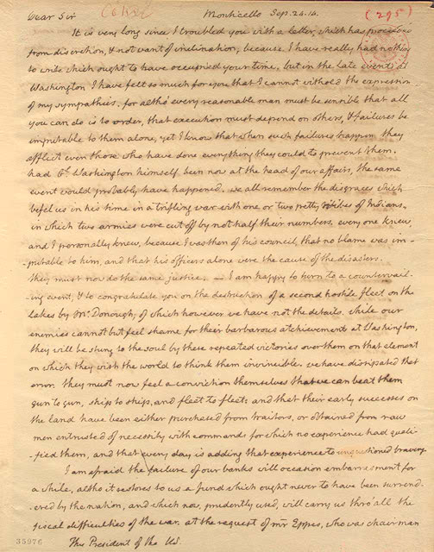
Thomas Jefferson
After the British burned the Capitol in 1814, destroying the congressional library, Thomas Jefferson offered to sell his books to Congress at a price they could name.
In this letter to his friend and President of the United States James Madison, Jefferson seeks his support for the sale, which members of Congress were then debating.
Thomas Jefferson to James Madison
(1751-1836)
Polygraph copy,
September 24, 1814
Manuscript Division

Slide 8
Francis Bacon's three faculties of the mind:
American Treasures
Memory
History
Reason Philosophy, Law, Science and Geography
Imagination Fine Arts, incl. Architecture, Music, Literature and Sports

Slide 9
Special Presentations
Shakespeare in America
Benjamin Franklin: In His Own Words
The Dream of Flight
Revising Himself: Walt Whitman and Leaves of Grass
More…Check it out!

Slide 10
Explore the Treasures
Go to http://www.loc.gov/exhibits/treasures/
On your handout, please choose 1 question to answer. Use the resources from the American Treasures to answer your question.
Share with your elbow buddy your responses to your questions.

Slide 11
Want to know more…
Contact Heather Johnson:
swede726@aol.com
View presentation at:
msjohnsonsroom.weebly.com
Create an online poll at polleverywhere.com

