Slide 1

Introduction to the Math Shifts of the Common Core
State Standards
Notes:
Today’s session is an overview of the key shifts that the Common Core State Standards require for mathematics. We will be learning about the 3 shifts through this slide show as well as through some hands-on activities to help us understand the key components of the shifts. Through this we hope to gain a better understanding of the Standards for Mathematics which in turn will better prepare our students.

Slide 2
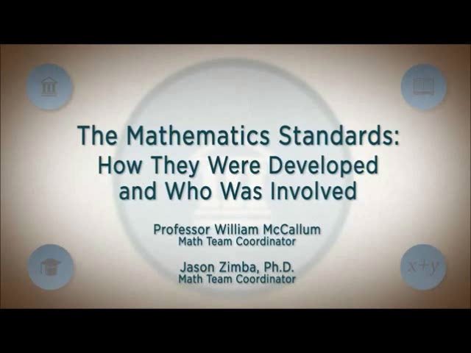
https://vimeo.com/92784226
Notes:
{show video}
William McCallum and Jason Zimba (two lead writers of the Common Core State Standards for Mathematics) on the background of writing the Standards.
This video, produced by The Hunt Institute, can be seen in its entirety at http://www.youtube.com/watch?v=dnjbwJdcPjE

Slide 3
The Background of the Common Core
Initiated by the National Governors Association (NGA) and Council of Chief State School Officers (CCSSO) with the following design principles:
  Result in College and Career Readiness
  Based on solid research and practice evidence
  fewer, higher, and clearer
Notes:
To have more students meet the requirements for post-secondary success, we needed greater clarity in what was expected of students each year during K-12 education.
Typical state standards that preceded the Common Core were too vague and too long to realistically inform instruction.
So the Common Core was designed to be a set of standards that are fewer in number, clearer in describing outcomes, and higher. What is included is what is expected for ALL students.
To help students achieve these standards, all practitioners must be honest about the time they require. Teaching less at a much deeper level really is the key to Common Core success.
The decisions surrounding how to focus the standards had to be grounded in evidence regarding what students in fact need in order to have a solid base of education and to be well prepared for career or college demands.
There had to be many decisions about what not to include. The focus was narrowed to what mattered most. You can look at the standards and probably agree that all of them are skills you would really want every student you know and care about to leave school able to exercise.
So the CCSS represent that rarest of moments in education when an effort starts by communicating that we must stop doing certain things, rather than telling educators about one more thing they can add to their already overbooked agenda to help support their students. You can think of the standards and this focus on the shifts that really are at the center of what is different about them as the “power of the eraser” over the power of the pen.

Slide 4
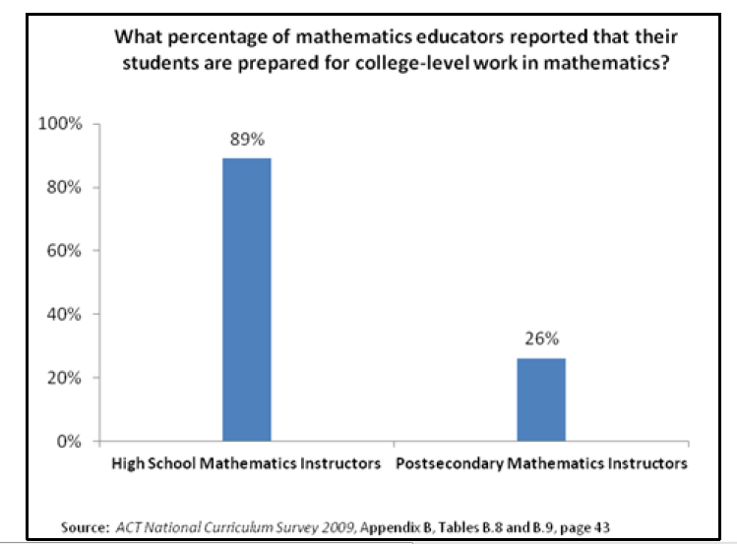
College Math Professors Feel HS students Today are Not Prepared for College Math
Notes:
We see that there is a disconnect between how prepared high school math educators believe their students are for college mathematics and how prepared post secondary math instructors feel the students are.
Notice that this slide shows that high school math teachers feel that 89% of their students are ready for college level math, while college math teachers feel only 26% of their students are prepared.
Rather than spend too much time and energy placing blame or thinking about why this disconnect exists, let’s instead turn to the implications of such a disconnect.

Slide 5
What The Disconnect Means for Students
Nationwide, many students in two-year and four-year colleges need remediation in math.
Remedial classes lower the odds of finishing the degree or program.
We need to set the agenda in high school math to prepare more students for postsecondary education and training.
Notes:
As mentioned before, many students in two and four year colleges need remediation in math, which often lowers their odds of finishing the degree or program they are in. Shouldn’t students who graduate from high school be prepared for postsecondary education and training?

Slide 6
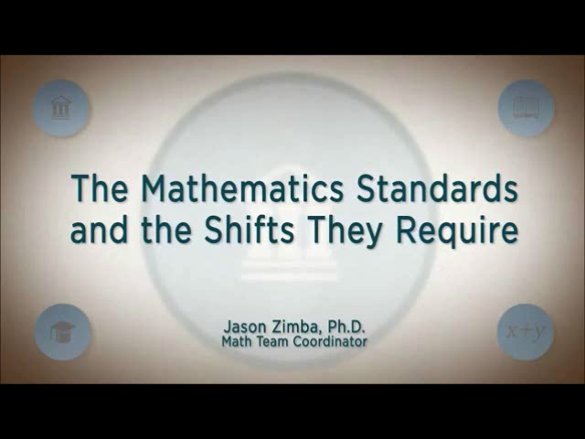
The CCSS Requires Three Shifts in Mathematics
Focus: Focus strongly where the Standards focus.
Coherence: Think across grades and link to major topics within grades.
Rigor: In major topics, pursue conceptual understanding, procedural skill and fluency, and application.
https://vimeo.com/92784227
Notes:
The Common Core State Standards for Mathematics were designed to address these issues. To learn more about the Standards we are going to talk about the three shifts, which represent the overarching messages in these new Standards.
Here are the three shifts in mathematics. {Read the slide}
These are not only things I’m (we’re) telling you, these are things I’m (we’re) asking you to tell other people. These are what you need to be fighting for. These are what you need to be thinking about when a speaker at a workshop or a publisher or even members of your district tell you about CCSS – you can test their message against these things. You can test anyone’s message against these touchstones. They are meant to be succinct, and easy to remember; we’ll discuss them each in turn.

Slide 7
Shift #1: Focus Strongly Where the Standards Focus
Significantly narrow the scope of content and deepen how time and energy is spent in the math classroom.
Focus deeply on what is emphasized in the standards, so that students gain strong foundations.
Notes:
What does it mean to focus? {Read slide}
So, focus in the Standards quite directly means that the scope of content is to be narrowed. This is that notion of “the power of the eraser”. After a decade of NCLB, we have come to see “narrowing” as a bad word – and when it means cutting arts programs and language programs, it is. But meanwhile, math has swelled in this country. It has become a mile wide and an inch deep. The CCSSM is telling us that math actually needs to lose a few pounds.
Just as important is that we are deepening expectations as well. So rather than skating through a lot of topics – covering the curriculum – we are going to have fewer topics on our list, but the expectations in those topics are much deeper. Without focus, deep understanding of core math concepts for all students is just a fantasy.
A study of the Standards reveals that there are areas of emphasis already engineered into the standards at each grade level.

Slide 8
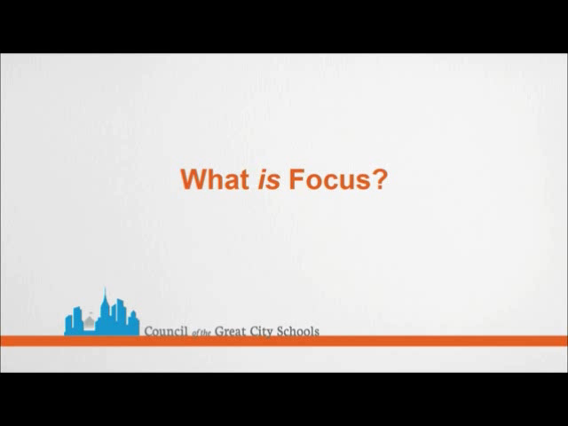
https://vimeo.com/92784228
Notes:
What is Focus?
“From the Page to the Classroom: Implementing the Common Core State Standards Mathematics. Produced by Council of the Great City Schools.” http://vimeo.com/44524812
Math curriculum in the U.S. has often been described as a “mile wide, inch deep.” We cover a lot of topics, but with very little depth. Because of the pressure we feel to “get through it all,” there is often little time to meet expectations of mastery for all students. The consequences of this is students only learning a little bit of a lot of things and the students not gaining insight or depth of understanding of the important math topics that will allow them successfully build on that understanding each year.

Slide 9
Focus
Move away from "mile wide, inch deep" curricula identified in TIMSS.
Learn from international comparisons.
Teach less, learn more.
“Less topic coverage can be associated with higher scores on those topics covered because students have more time to master the content that is taught.”
– Ginsburg et al., 2005
Notes:
The Third International Math and Science Study (TIMSS) not only ranks assessment performance of many industrialized nations, but also analyzes the education systems of those countries. The TIMSS study showed that the U.S. covers far more topics than those countries that significantly outperform us. In fact, the TIMSS study revealed that in grade 4, high scoring Hong Kong omitted 48 percent of the TIMSS items. The U.S., on average, omitted only 17%. In the U.S. we have been covering more topics with the net result of learning less about them.
Interestingly, the slogan on the Singapore Ministry of Education’s website is “Teach less, learn more.” By focusing curriculum and instruction, teachers have the opportunity to support students in the development of strong foundations that pay off as the progress through more complex math concepts.
{read quote from bottom of slide}

Slide 10
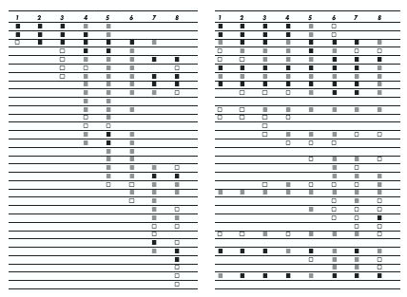
The shape of math in A+ countries
Mathematics topics intended at each grade by at least two-thirds of A+ countries
Mathematics topics intended at each grade by at least two-thirds of 21 U.S. states
¹ Schmidt, Houang, & Cogan, “A Coherent Curriculum: The Case of Mathematics.” (2002).
Notes:
There are no detailed labels here because I want you to see visually that the overall shape of math topics in A+ countries and those typical in the US (pre-Common Core) is different.
Each row is a math topic, like fractions, or congruence.
In 2/3rds of the high-performing countries, the foundations are laid and then further knowledge is built on them. The design principle is focus and coherent progressions.
In the U.S., the design principle is to teach everything every year that can possibly be taught… as well as many things that cannot.

Slide 11
Traditional U.S. Approach
 | K 12
Number and Operations
Measurement and Geometry
Algebra and Functions
Statistics and Probability
Notes:
This slide represents another visualization of how U.S standards used to be arranged, giving equal importance to all four areas - like “shopping aisles.” Each grade goes up and down the aisles, tossing topics into the cart, losing focus.
There is no disagreement, for example, that the most critical area of mathematics in K-2 is numbers and operations. However, whether looking at typical state standards or typical curriculum that followed, numbers and operations was just one concept among many that was included.
The Common Core State Standards is a set of standards that allow teachers to do what they know they need to in order to support the further development of their students: concentrate on fewer, powerful concepts and then build on those.

Slide 12
Focusing Attention Within Number and Operations
 | Operations and Algebraic Thinking |  |  |  |  |  |  | Expressions and Equations |  |  |  | Algebra
 |  |  |  |  |  |  | → |  |  |  | →
 | Number and Operations—Base Ten |  |  |  |  |  | → | The Number System
 |  |  |  |  |  |  |  |  |  |  | →
 |  |  |  | Number and Operations—Fractions |  |  | →
 | K | 1 | 2 | 3 | 4 | 5 |  | 6 | 7 | 8 |  | High School
Notes:
The CCSS takes the first strand from the last slide (Number and Operations) and expands it to show the relevance and progression of number and operations from K-12. You can see that the one "shopping aisle" or strand of Number and Operations from previous states standards is now split into 5 domains across the K-8 grade span, communicating exactly what is being learned at each grade and clarifying how that learning prepares the students for future studies.

Slide 13
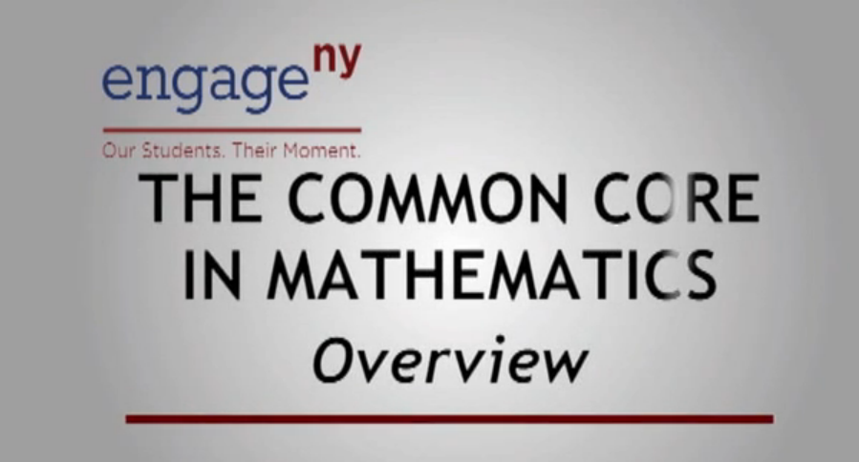
https://vimeo.com/92784229
Notes:
David Coleman speaking on focus in the Common Core State Standards. This video, produced by Engage NY, can be seen in its entirety at http://vimeo.com/27066753

Slide 14
Key Areas of Focus in Mathematics
Grade | Focus Areas in Support of Rich Instruction and Expectations of Fluency and Conceptual Understanding
K–2 | Addition and subtraction - concepts, skills, and problem solving and place value
3–5 | Multiplication and division of whole numbers and fractions – concepts, skills, and problem solving
6 | Ratios and proportional reasoning; early expressions and equations
7 | Ratios and proportional reasoning; arithmetic of rational numbers
8 | Linear algebra and linear functions
Notes:
Focus in the Common Core Standards means two things. What is in versus what is out, but also what the main focus areas of the standards are for each grade. This chart shows what the major focus areas are for K-8 math. These are the concepts which demand the most time, attention, and energy throughout the school year. It is through focus in these key areas in K-8 that students will be best be prepared for further studies of math in HS and, consequently, college and career ready.
It is important to note that these are not topics to be checked off a list during an isolated unit of instruction, but rather these priority areas will be present throughout the school year through rich instructional experiences.

Slide 15
Group Discussion
Shift #1: Focus strongly where the Standards focus.
In your groups, discuss ways to respond to the following question, “Why focus? There’s so much math that students could be learning, why limit them to just a few things?”
Notes:
{Pass out practice with shifts handout. Read the question from the top of handout – same as slide}
Take a few minutes to discuss this question.

Slide 16
Engaging with the shift: What do you think belongs in the major work of each grade?
Grade | Which two of the following represent areas of major focus for the indicated grade?
K | Compare numbers | Use tally marks | Understand meaning of addition and subtraction
1 | Add and subtract within 20 | Measure lengths indirectly and by iterating length units | Create and extend patterns and sequences
2 | Work with equal groups of objects to gain foundations for multiplication | Understand place value | Identify line of symmetry in two dimensional figures
3 | Multiply and divide within 100 | Identify the measures of central tendency and distribution | Develop understanding of fractions as numbers
4 | Examine transformations on the coordinate plane | Generalize place value understanding for multi-digit whole numbers | Extend understanding of fraction equivalence and ordering
5 | Understand and calculate probability of single events | Understand the place value system | Apply and extend previous understandings of multiplication and division to multiply and divide fractions
6 | Understand ratio concepts and use ratio reasoning to solve problems | Identify and utilize rules of divisibility | Apply and extend previous understandings of arithmetic to algebraic expressions
7 | Apply and extend previous understandings of operations with fractions to add, subtract, multiply, and divide rational numbers | Use properties of operations to generate equivalent expressions | Generate the prime factorization of numbers to solve problems
8 | Standard form of a linear equation | Define, evaluate, and compare functions | Understand and apply the Pythagorean Theorem
Alg.1 | Quadratic inequalities | Linear and quadratic functions | Creating equations to model situations
Alg.2 | Exponential and logarithmic functions | Polar coordinates | Using functions to model situations
Notes:
Without looking at your standards, please work with those around you to determine what two topics of each row are major work of that grade. You could circle the 2 topics that are major work, or cross out the one that is not. A hint to this is that the one item that is not the major work of the grade is actually not even part of the standards for that grade.
{After a sufficient amount of time, have participants share their answers. An “answer key” can be found in the resources for this module.}

Slide 17
Shift #2: Coherence: Think Across Grades, and Link to Major Topics Within Grades
Carefully connect the learning within and across grades so that students can build new understanding on foundations built in previous years.
Begin to count on solid conceptual understanding of core content and build on it. Each standard is not a new event, but an extension of previous learning.
Notes:
{Read slide}
In the second shift, coherence, we take advantage of focus to actually pay attention to sense-making in math. Coherence speaks to the idea that math does not consist of a list of isolated topics.
The Standards themselves, and therefore any resulting curriculum and instruction, should build on major concepts within a given school year as well as major concepts from previous school years.
Typically, current math curriculum spends as much as 25% of the instructional school year on reviewing and re-teaching previous grade level expectations – not as an extension – but rather as a re-teaching because many students have very little command of critical concepts.

Slide 18
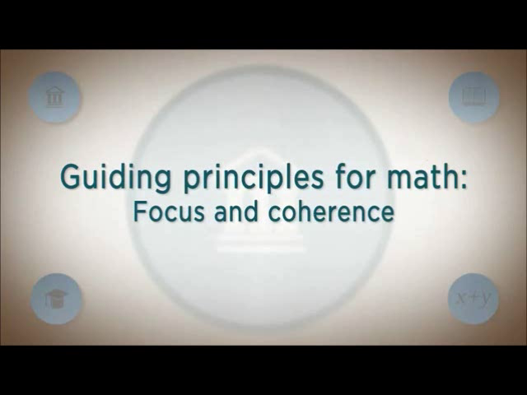
https://vimeo.com/92784230
Notes:
William McCallum speaking on coherence.
This video, produced by the Hunt Institute, can be seen in its entirety at http://www.youtube.com/watch?v=83Ieur9qy5k&list=UUF0pa3nE3aZAfBMT8pqM5PA&index=7&feature=plcp

Slide 19
Coherence: Think Across Grades
Example: Fractions
“The coherence and sequential nature of mathematics dictate the foundational skills that are necessary for the learning of algebra. The most important foundational skill not presently developed appears to be proficiency with fractions (including decimals, percents, and negative fractions). The teaching of fractions must be acknowledged as critically important and improved before an increase in student achievement in algebra can be expected.”
Final Report of the National Mathematics Advisory Panel (2008, p. 18)
Notes:
{read slide regarding fraction example}
As an example of coherence, the Common Core State Standards takes a different approach to preparing students for success in algebra. Previous approaches moved topics of pre-algebra and algebra earlier and earlier in the grade sequence rather than attend to careful progressions of conceptual development that in fact prepare students for algebra.

Slide 20
CCSS
4.NF.4. Apply and extend previous understandings of multiplication to multiply a fraction by a whole number.
Grade 4
5.NF.4. Apply and extend previous understandings of multiplication to multiply a fraction or whole number by a fraction.
5.NF.7. Apply and extend previous understandings of division to divide unit fractions by whole numbers and whole numbers by unit fractions.
Grade 5
6.NS. Apply and extend previous understandings of multiplication and division to divide fractions by fractions.
6.NS.1. Interpret and compute quotients of fractions, and solve word problems involving division of fractions by fractions, e.g., by using visual fraction models and equations to represent the problem.
Grade 6
Informing Grades 1-6 Mathematics Standards Development: What Can Be Learned from High-Performing Hong Kong, Singapore, and Korea? American Institutes for Research (2009, p. 13)
Notes:
Here you see some of the international data that informed the development of the CCSSM. On the left you see a coherent progression of multiplication and division of fractions over three grade levels.
On the right you see excerpts from the Common Core that address fractions with purpose and direction. The term “apply and extend previous understandings…” is a sure sign of the expectation within a progression of concept development.
Looking at the progression of multiplying and dividing fractions, you will see that over these 3 years the students are building on previous knowledge and not just repeating the same thing each year. You’ll see that in 4th grade students apply and extend previous understandings of multiplication to multiply a fraction by a whole number. In 5th grade that knowledge and skill is extended to multiply a fraction or whole number by a fraction. Also in 5th grade, students extend previous understandings of division to divide unit fractions by whole numbers and the reverse. In 6th grade, students will continue to build on the foundations laid and will divide fractions by fractions. These are clear and carefully laid progressions.

Slide 21


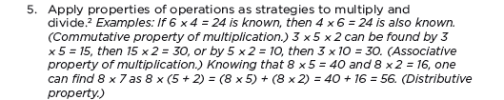

Alignment in Context: Neighboring Grades and Progressions
One of several staircases to algebra designed in the OA domain.
21
Notes:
Algebra begins in 6.EE.3 in its cleanest sense. Here is a beautiful illustration of the design of the standards.
{read slide}

Slide 22
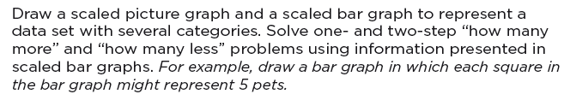
Coherence: Link to Major Topics Within Grades
Example: Data Representation
Standard 3.MD.3
Notes:
Instead of bar charts being “yet another thing to cover,” detracting from focus, the standard is telling you how to “aim” bar charts back around to the major work of the grade. These connections are explicit in the standards. While in the past picture or bar graphs might have been distinct things to be assessed, now they need to be connected to the major work of the grade.

Slide 23
Coherence: Link to Major Topics Within Grades
Example: Geometric Measurement
3.MD, third cluster
Notes:
Another example of coherence within a grade: Area is not just another topic to cover in Grade 3 . It is explicitly linked to addition and multiplication in the standards. This is clear in 5th grade as well when volume is introduced.

Slide 24
Group Discussion
Shift #2: Coherence: Think across grades, link to major topics within grades
In your groups, discuss what coherence in the math curriculum means to you. Be sure to address both elements—coherence within the grade and coherence across grades. Cite specific examples.
Notes:
{Page 2 of practice with shifts handout. Read the question from the top of handout – same as slide}
Take a few minutes to discuss this question.

Slide 25
Engaging with the Shift: Investigate Coherence in the Standards with Respect to Fractions
In the space below, copy all of the standards related to multiplication and division of fractions and note how coherence is evident in these standards. Note also standards that are outside of the Number and Operations—Fractions domain but are related to, or in support of, fractions.
Notes:
Continuation of page 2 of practice with the shifts.
{Participants will need to have access to the full Standards document. It is critical that teachers are aware of what is happening across grades, not only their grade or grade band.
The coherence of multiplying and dividing fractions is a great example to show coherence across grades. Even though this progression was touched on during the previous slides, all teachers from K-12 can benefit from this exercise. Even high school teachers can gain critical information from seeing the development of certain concepts like multiplication and division of fractions.
Participants need not write the entire standard, but should summarize the standards for this exercise.
Some teachers will take this coherence all the way back to 1st or 2nd grade and will continue it until the multiplication and division of rational numbers in 7th grade.
There is an answer key in the module.}

Slide 26
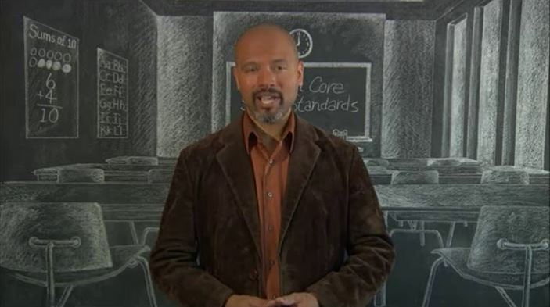
Shift #3: Rigor: In Major Topics, Pursue Conceptual Understanding, Procedural Skill and Fluency, and Application
https://vimeo.com/92830168
Notes:
The third shift is Rigor. This word can mean many different things. For purposes of describing the shifts of the standards, it does not mean “more difficult.” For example, stating that “the standards are more rigorous” does not mean that “the standards are just harder.” Here rigor is about the depth of what is expected in the standards, and also about what one should expect to see happening in the classroom, in curricular materials, and so on.
{read slide}
This video entitled “From the Page to the Classroom: Implementing the Common Core State Standards Mathematics. Produced by Council of the Great City Schools.” http://vimeo.com/44524812

Slide 27
Rigor
The CCSSM require a balance of:
    Solid conceptual understanding
    Procedural skill and fluency
    Application of skills in problem solving situations
Pursuit of all three requires equal intensity in time, activities, and resources.
Notes:
{read slide}

Slide 28
Solid Conceptual Understanding
Teach more than “how to get the answer” and instead support students’ ability to access concepts from a number of perspectives
Students are able to see math as more than a set of mnemonics or discrete procedures
Conceptual understanding supports the other aspects of rigor (fluency and application)
Notes:
One aspect of rigor is building solid conceptual understanding. Once we have a set of standards that are in fact focused, teachers and students have the time and space to develop solid conceptual understanding. {read the slide} There is no longer the pressure to quickly teach students how to superficially get to the answer, often relying on tricks or mnemonics. The standards instead require a real commitment to understanding mathematics, not just how to get the answer.
As an example, it is not sufficient to simply know the procedure for finding equivalent fractions, but students also need to know what it means for numbers to be written in equivalent forms.
Attention to conceptual understanding is one way that we can start counting on students building on prior knowledge. It is very difficult to build further math proficiency on a set mnemonics or discrete procedures.

Slide 29
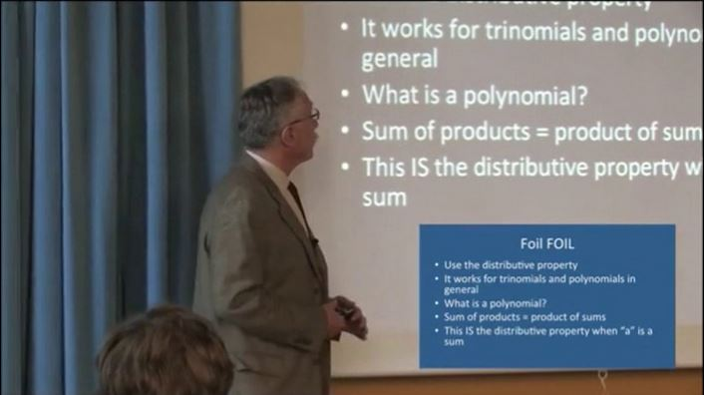
https://vimeo.com/92830193
Notes:
Phil Daro (a lead writer of the CCSSM) discussing conceptual understanding versus “answer getting”.
This video can be seen in its entirety at http://vimeo.com/30924981

Slide 30
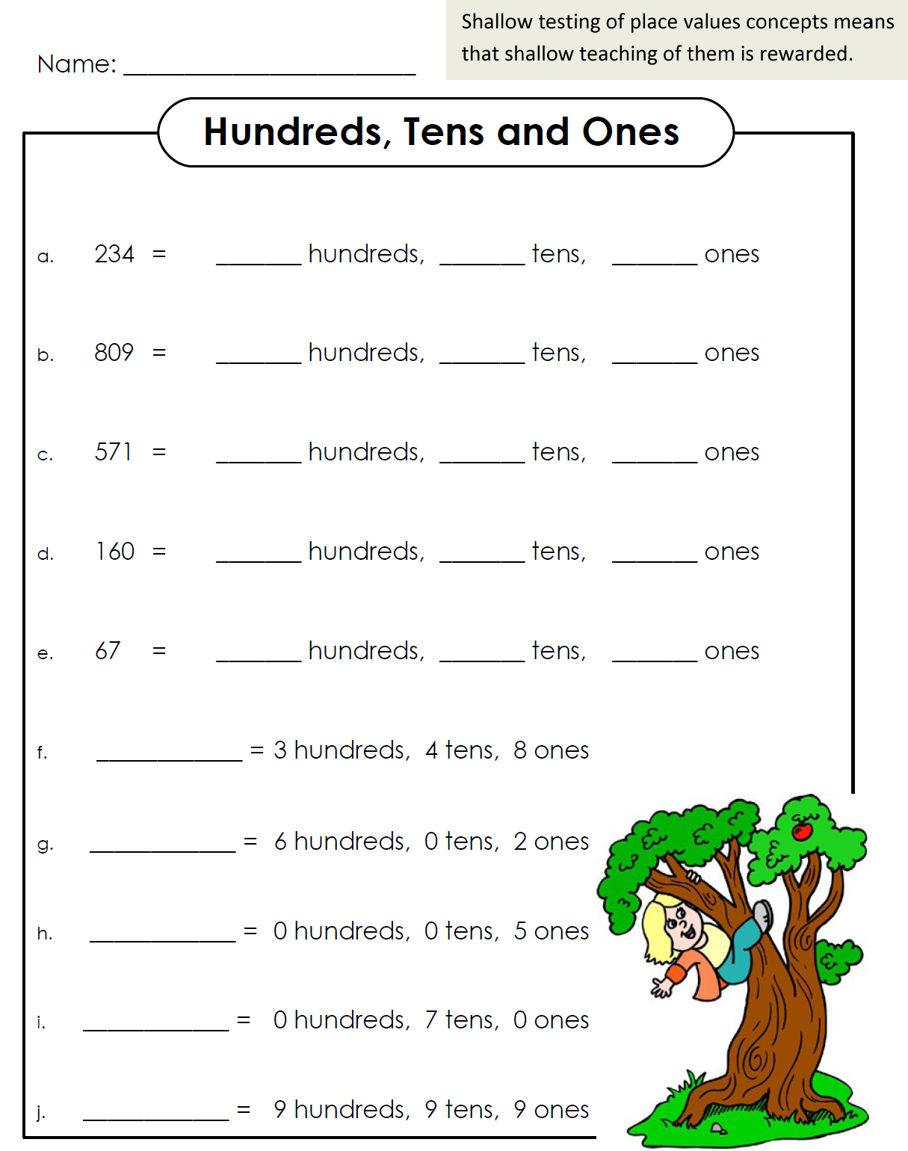
Notes:
Here is an example of a place value chart that you get when you search for “place value worksheets” online. It is also a non-example of work that would elicit conceptual understanding. As you can see, it would not be possible to assess whether your students had a conceptual understanding of place value by them completing this worksheet. It would be fairly obvious to a student who does not understand place value that the first number goes with hundreds, the 2nd number with tens and so on. Even on problem letter h, where it could have asked for deeper understanding, the worksheet places a 0 for tens to eliminate any need for thinking.

Slide 31
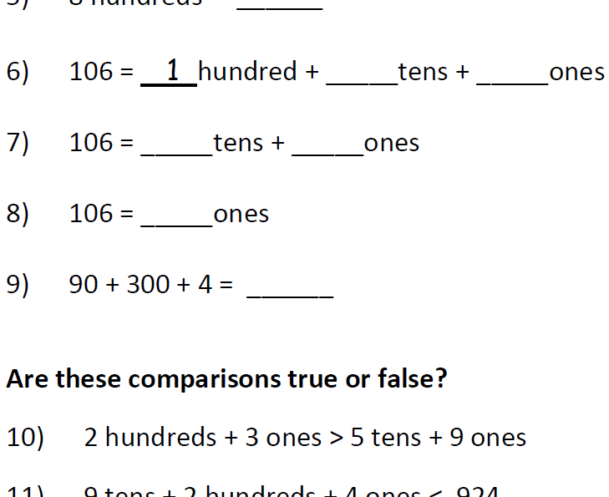
Notes:
Here is a snapshot of a worksheet practicing place value understanding. You can see how a teacher would be able to assess a student’s conceptual understanding of place value more clearly with the results of this worksheet. In problems 6-8, the base ten units in 106 are bundled in different ways. This is helpful when learning how to subtract in a problem like 106-37. In #9, we see that if the order is always given “correctly,” then all we do is teach students rote strategies without thinking about the size of the units or how to encode them in positional notation.

Slide 32
Fluency
The standards require speed and accuracy in calculation.
Teachers structure class time and/or homework time for students to practice core functions such as single-digit multiplication so that they are more able to understand and manipulate more complex concepts
Notes:
Another aspect of rigor is procedural skill and fluency. {read slide}
Note that this is not memorization absent understanding. This is the outcome of a carefully laid out learning progression.
At the same time, we can’t expect fluency to be a natural outcome without addressing it specifically in the classroom and in our materials. Some students might require more practice than others, and that should be attended to.
Additionally, there is not one approach to get to speed and accuracy that will work for all students. All students, however, will need to develop a way to get there.
It is important to note here that while teachers in grades K-5 may find creative ways to use calculators in the classroom, students are not meeting the standards when they use them--not just in the area of fluency, but in all other areas of the Standards as well.

Slide 33
Required Fluencies in K-6
Grade | Standard | Required Fluency
K | K.OA.5 | Add/subtract within 5
1 | 1.OA.6 | Add/subtract within 10
2 | 2.OA.2 2.NBT.5 | Add/subtract within 20 (know single-digit sums from memory) Add/subtract within 100
3 | 3.OA.7 3.NBT.2 | Multiply/divide within 100 (know single-digit products from memory) Add/subtract within 1000
4 | 4.NBT.4 | Add/subtract within 1,000,000
5 | 5.NBT.5 | Multi-digit multiplication
6 | 6.NS.2,3 | Multi-digit division Multi-digit decimal operations
Notes:
This chart shows a breakdown of the required fluencies in grades K-6.
Fluent in the particular Standards cited here means “fast and accurate.” It might also help to think of fluency in math as similar to fluency in a foreign language: when you’re fluent, you flow. Fluent isn’t halting, stumbling, or reversing oneself.
The word fluency was used judiciously in the Standards to mark the endpoints of progressions of learning that begin with solid underpinnings and then pass upward through stages of growing maturity.
Some of these fluency expectations are meant to be mental, others need pencil and paper. But for each of them, there should be no hesitation about how to proceed in getting the answer with accuracy.

Slide 34
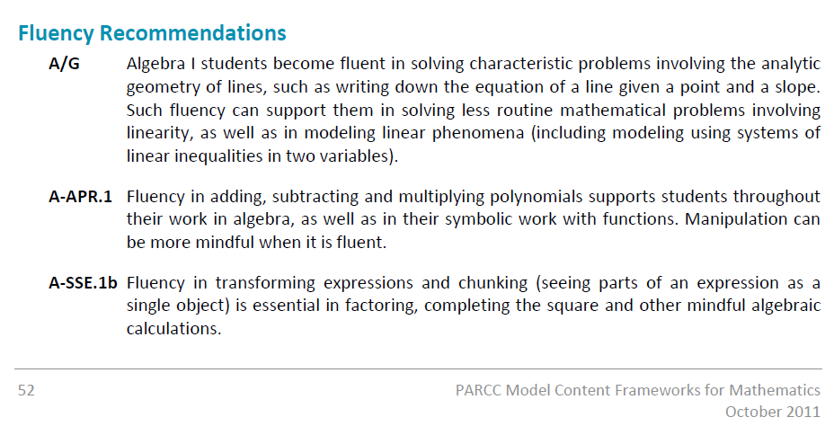
Fluency in High School
Notes:
There are some key aspects of high school math that also require speed and accuracy. There are no specific fluency requirements in the HS content standards, but these are suggestions for fluency based on what is being asked of the students at this level. {Note that more of these recommendations can be found in the PARCC Model Content Frameworks.}

Slide 35
Application
Students can use appropriate concepts and procedures for application even when not prompted to do so.
Teachers provide opportunities at all grade levels for students to apply math concepts in “real world” situations, recognizing this means different things in K-5, 6-8, and HS.
Teachers in content areas outside of math, particularly science, ensure that students are using grade-level-appropriate math to make meaning of and access science content.
Notes:
Using mathematics in problem solving contexts is the third leg of the stool supporting the learning that is going on in the math classroom.
This is the “why we learn math” piece, right? We learn it so we can apply it in situations that require mathematical knowledge. There are requirements for application all the way throughout the grades in the CCSS. {read slide} But again, we can’t just focus solely on application—we need also to give students opportunities to gain deep insight into the mathematical concepts they are using and also develop fluency with the procedures that will be applied in these situations. The problem-solving aspect of application is what’s at stake here—if we attempt this with a lack of conceptual knowledge and procedural fluency, the problem just becomes three times harder.
At the same time, we don’t want to save all the application for the end of the learning progression. Application can be motivational and interesting, and there is a need for students at all levels to connect the mathematics they are learning to the world around them.

Slide 36
Group Discussion
Shift #3: Rigor: Expect fluency, deep understanding, and application
In your groups, discuss ways to respond to one of the following comments: “These standards expect that we just teach rote memorization. Seems like a step backwards to me.” Or “I’m not going to spend time on fluency—it should just be a natural outcome of conceptual understanding.”

Slide 37
Engaging with the Shift: Making a True Statement
Rigor = ______ + ________ + _______
This shift requires a balance of three discrete components in math instruction. This is not a pedagogical option, but is required by the Standards. Using grade __ as a sample, find and copy the standards which specifically set expectations for each component.
Notes:
{note to presenter – you may fill in either grade 3 or grade 6 for this activity, or have them choose, depending on your audience}
Continuing on page 3 of the practicing with the shifts handout, who can fill in the blanks of the three components of rigor in the Standards?
Next we will find and copy the standards for grade 3 (or 6) which specifically set expectations for fluency, conceptual understanding or application. {You may want to remind the participants that the Standards are very clear about this and give the hint that the fluency standards say “fluent” the conceptual understanding standards often use the word “understand” or “relate” and the application standards often say “real world problem.”}
You will have 10 minutes to locate the Standards – you may find that sometimes there is overlap between two components. You can just write the code of the standard instead of writing the entire standard.
{Discuss the results – see sample answer in the module packet}

Slide 38
It Starts with Focus
The current U.S. curriculum is "a mile wide and an inch deep."
Focus is necessary in order to achieve the rigor set forth in the standards.
Remember Hong Kong example: more in-depth mastery of a smaller set of things pays off.
Notes:
Where do we start?
It is very easy to feel overwhelmed by all that is being asked of us in these standards – as stated earlier, this is not just a few shifts in teaching a few topics at different grades then we are use to. The Common Core State Standards in math require big shifts in how math is being taught, practiced, and assessed in the U.S. But where do we start? It starts with Focus.
Remember that we only get opportunities to support coherence and rigor when we first focus.

Slide 39

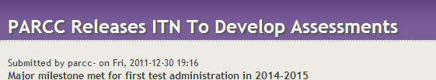
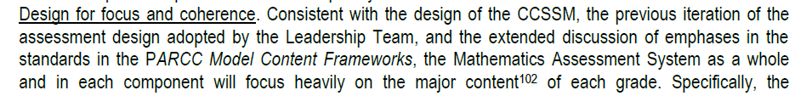
The Coming CCSS Assessments Will Focus Strongly on the Major Work of Each Grade
Notes:
{Give the following background on the assessment consortia, if needed: In an effort to provide ongoing feedback to teachers during the course of the school year, measure annual student growth, and move beyond narrowly-focused bubble tests, the U.S. Department of Education has awarded two groups of states grants to develop a new generation of tests. The new tests will be aligned to the Common Core State Standards. The tests will assess students' knowledge of mathematics and English Language Arts from third grade through HS. PARCC (The Partnership for Assessment of Readiness for College and Careers) and SBAC (Smarter Balanced Assessment Consortium) are the two assessment consortia.}
Both Smarter Balanced and PARCC are committed to focusing their assessments on the major work of each grade.
{Read quote(s) that is/are meaningful for your audience.}

Slide 40
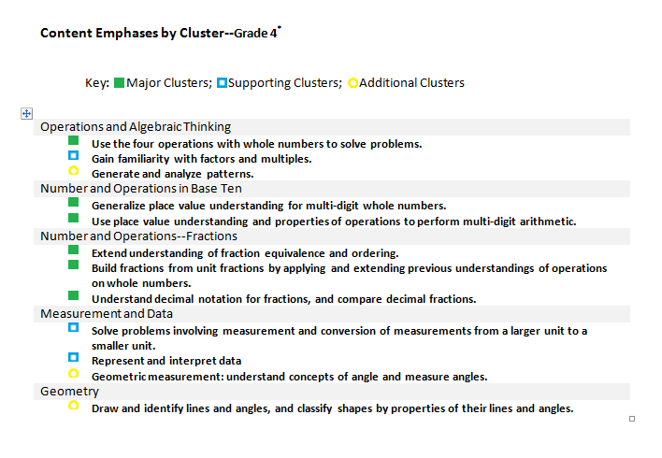
Content Emphases by Cluster: Grade Four
Key: Major Clusters; Supporting Clusters; Additional Clusters
Notes:
Here is an example of how focus and coherence works in a single grade. This is the emphases by cluster chart for fourth grade. The green boxes represent the major work of the grade, the blue are the clusters that support the major work of the grade, and the yellow are the additional clusters.
The emphases charts make visible the intended focus and coherence of the subject matter by identifying the major work (focus) and the supporting and additional work (coherence within and across)
For example, here are some connections between supporting and major.
- Gain familiarity with factors and multiples: Work in this cluster supports students work with multi-digit arithmetic as well as their work with fraction equivalence.
- Represent and interpret data: The standard in this cluster requires students to use a line plot to display measurements in fractions of a unit and to solve problems involving addition and subtraction of fractions, connecting it directly to the Number and Operations--Fractions clusters.

Slide 41
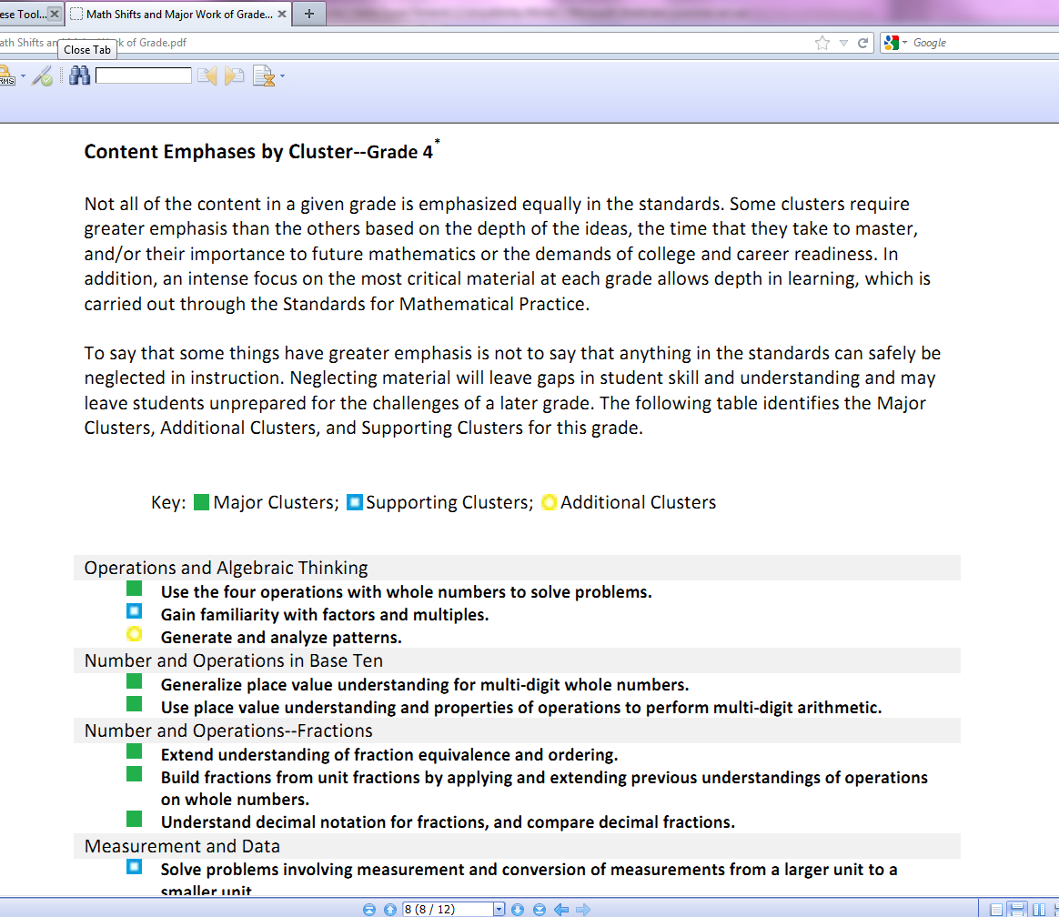

www.achievethecore.org
41
Notes:
The content emphases can be found at the achievethecore.org website.

Slide 42
Cautions: Implementing the CCSS is...
Not about “gap analysis”
Not about buying a text series
Not a march through the standards
Not about breaking apart each standard
Notes:
As decisions are made going forward, there are some cautions worth noting.
A simple gap analysis between what topics we used to teach and where those topics exist in the Common Core is not an adequate approach to take. Such a topical gap analysis rarely addresses what we should not longer include in a curriculum. It does not address the conceptual understanding, fluency and rigor expectations, and most importantly it does not result in the signaling of focus on the major work of the grade.
Another important note is that these standards do not dictate a particular order or scope and sequence. Students should not be marched through these standards one at a time, but rather many of these expectations develop over the course of the year.
The architecture of the standards documents matters a lot. The domains and cluster headings are very purposefully organized to support teaching and learning of the standards. Take every opportunity to build on understanding and develop math proficiency rather than just going over or covering a list of math topics.

Slide 43

https://vimeo.com/92830194
Notes:
Monica Sims (a 5th grade teacher) speaking about the Standards. This video, produced by America Achieves, can be seen in its entirety at http://commoncore.americaachieves.org/.

Slide 44
Structure of the Standards
Domains are large groups of related standards. Domains change from grade to grade to reflect the changing focus of each grade. Standards from different domains may sometimes be closely related.
Clusters are groups of related standards. Each domain has 1 – 4 clusters. Standards from different clusters may sometimes be closely related.
Standards define what students should understand and be able to do.
Domain
Cluster
Standard
Notes:
{THE NEXT TWO SLIDES ARE INCLUDED TO PROVIDE PARTICIPANTS WITH AN OVERVIEW OF THE OVERALL STRUCTURE AND CONTENT OF THE STANDARDS}
There are five domains for each grade K-8: Counting and Cardinality, Operations and Algebraic Thinking, Number and Operations in Base Ten, Number and Operations – Fractions, Ratios and Proportional Relationships, The Number System, Expressions and Equations, Measurement and Data, Geometry, Statistics and Probability and Functions.
The high school standards are listed in conceptual categories: Number and Quantity, Algebra, Functions, Modeling, Geometry, and Statistics and Probability.

Slide 45
Identify the Standard
5.NBT.4
Grade
Domain
Standard Number
3.OA.C
Grade
Domain
Cluster
Notes:
Ask participants to identify the specific standard noted on the slide.
Note that C represents the third cluster in the domain of OA. The letter designation of the clusters are not labeled in the printed form of the CCSS. A=first cluster, B=second cluster, etc.
Grade 5; Number & Operations in Base Ten; Standard #4
“Use place value understanding to round decimals to any place.”
Grade 3; Operations and Algebraic Thinking; Third Cluster
“Multiply and divide within 100.”

